Slide 1
ZAGREB
City of art

Slide 2
Capital city
Zagreb is the capital and the largest city of Croatia.
The population is about 800 000
The biggest city districts are Donji Grad, Trnje, Trešnjevka, Maksimir, Novi Zagreb and Medvešćak.

Slide 3
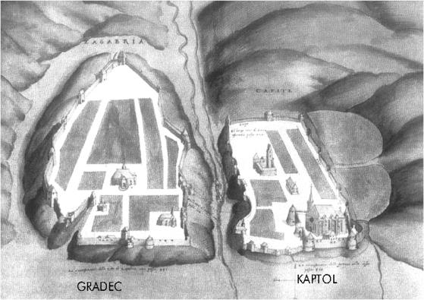
History
Zagreb as we know it today, which is to say its historical centre, dates back to the Middle Ages, and the settlements on two hills: secular Gradec, today known as the Upper Town; and ecclesiastical Kaptol.

Slide 4
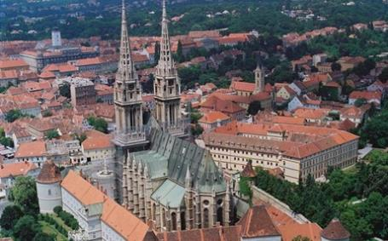
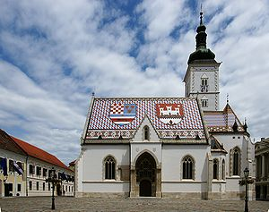
Churches
The first written record of Zagreb dates back to 1094 when the Hungarian king Ladislav established the Kaptol diocese on his way to the Adriatic Sea. The Zagreb Cathedral still dominates the skyline with its neo-Gothic style, while the Renaissance walls surrounding it are rare preserved examples of their kind in this part of Europe.
The Church of St. Marko is the parish church of old Zagreb, located in St. Marko's Square.

Slide 5
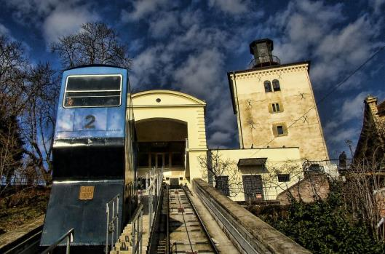
The Lotrščak tower
In the mid-13th century the Tatars ravaged Hungary and their king Bela IV fled to Zagreb where its citizens provided him with a refuge. In gratitude, in 1242 Béla gave Gradec a charter proclaiming it a free royal city. His generosity is symbolically reenacted every day by the blasting of the cannonat noon from the Lotrščak tower overlooking central Zagreb.

Slide 6
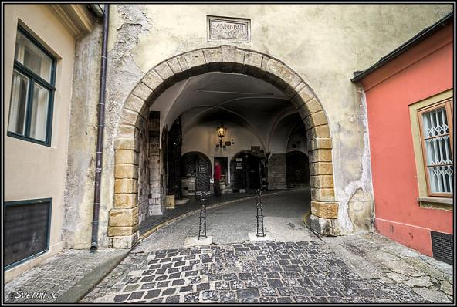
Kamenita vrata
In the Middle Ages bells were sounded to warn the citizens to return to the fort as the gates to the city were about to be closed and locked.
The only gate preserved from the Middle Ages, Kamenita vrata (Stone door), was burned down in the first half of the 18th century.
Miraculously, the only thing saved in the fire was an icon of the Virgin Mary that still occupies its prime spot in the wall.

Slide 7
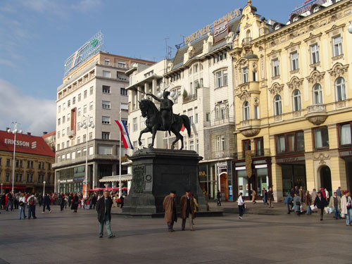
The ban Josip Jelačić square
In time the threats of attack subsided and the city started to spread out around the valley. A trading centre below the two settlements evolved into what is now the main square of Ban Josip Jelačić. This is the heart of the city and a meeting point for all Zagreb citizens.

Slide 8
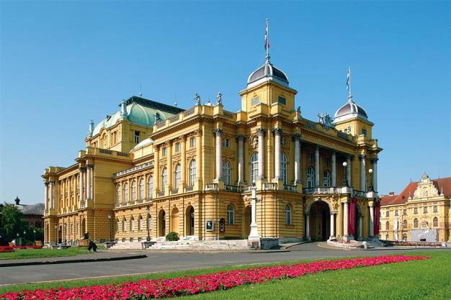
Croatian National Theatre
Zagreb enjoys a rich cultural life. Around 30 theatres are active in the city, some with regular programmes, some occasional. Croatian National Theatre is the national home of ballet, opera and drama.

Slide 9
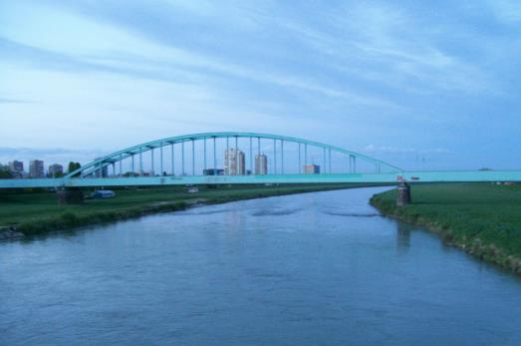
River Sava
Zagreb is located in the northwest of the country, along the Sava river.For centuries, the Sava had been flooding the valley while protecting citizens from medieval invasion and serving as a link to distant lands. From the mid-20th century it became the border between the old town of Zagreb and Novi Zagreb.

Slide 10
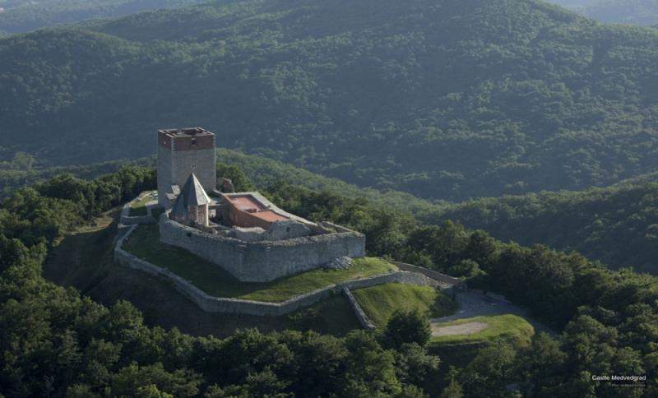
Medvednica
The city is protected from the cold northern winds by the mountain of Medvednica (Bear Hills) , a popular destination where you can find spaces for recreation.

Slide 11
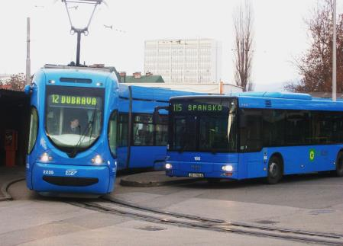
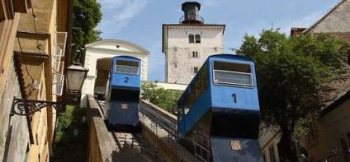
Public transportation
The public transportation company ZET operates trams and buses.
They are known for their blue colour.
The funicular in the historic part of the city is a tourist attraction.

Slide 12
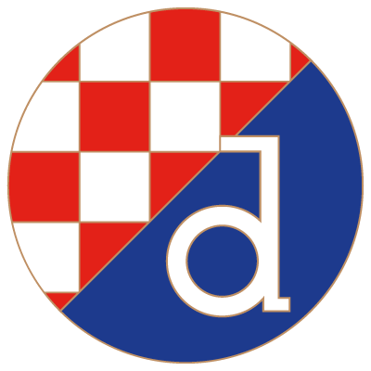
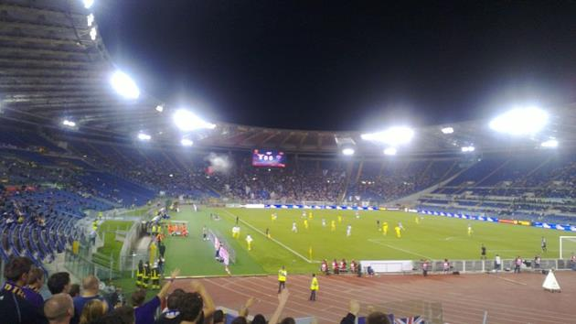
Sport
Dinamo Zagreb is a Croatian football club based in Zagreb.
They are the most successful club in Croatian football.
They play their home matches at Stadion Maksimir.

Slide 13
Food
Domestic products which deserve to be tasted include turkey, duck or goose with mlinci (a kind of pasta), štrukli (cottage cheese strudel), sir i vrhnje (cottage cheese with cream), kremšnite (custard slices in flaky pastry), and orehnjača (traditional walnut roll).

Slide 14
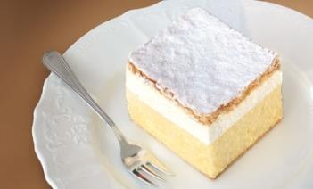
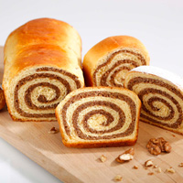
ŠTRUKLI
KREMŠNITA
OREHNJAČA
SIR I VRHNJE

